Slide 1
Improved structure for Knowledge Distillation
Deep Learning : Statistical perspective
2014-18323 Chanhwa Lee
2015-12868 Seung Hoon Paik

Slide 2
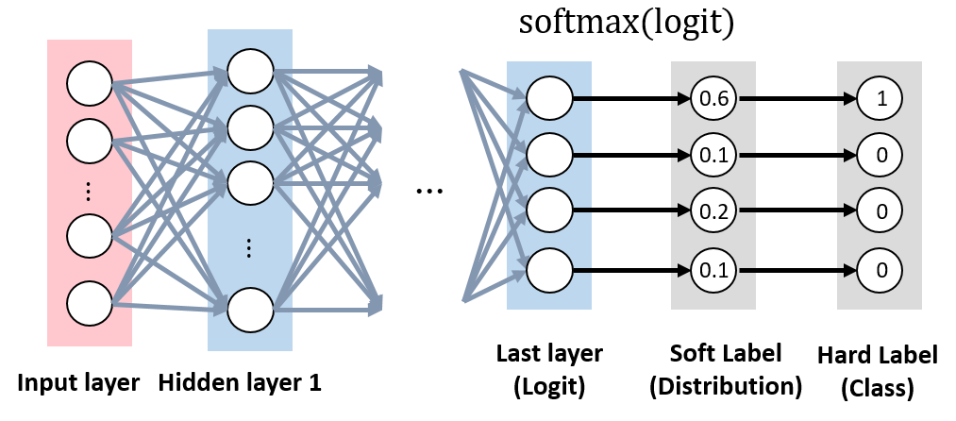
Soft Label
Soft Label contains correlation between classes
Notes:
We first remind you

Slide 3
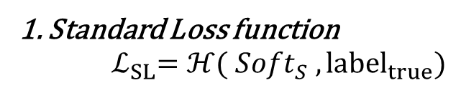
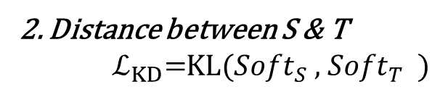
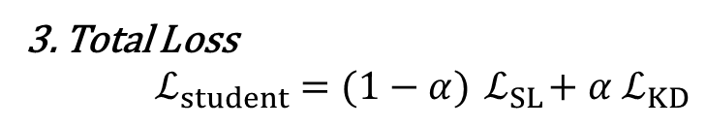
What is KD?
Teacher
pre-trained large
1. Standard Loss function
${ ℒ}_{SL}=ℋ({ Soft}_{S} , {label}_{true})$
2. Distance between S & T
${ ℒ}_{KD}=$KL(${Soft}_{S}$ , ${Soft}_{T}$ )
KD
Student
3. Total Loss
$${ ℒ}_{student} =(1−α){ ℒ}_{SL}+α{ ℒ}_{KD}$$
Hinton(2015) popularized Knowledge Distillation
Compress large model to smaller one
Notes:
Most KD research use MNIST and CIFAR dataset

Slide 4
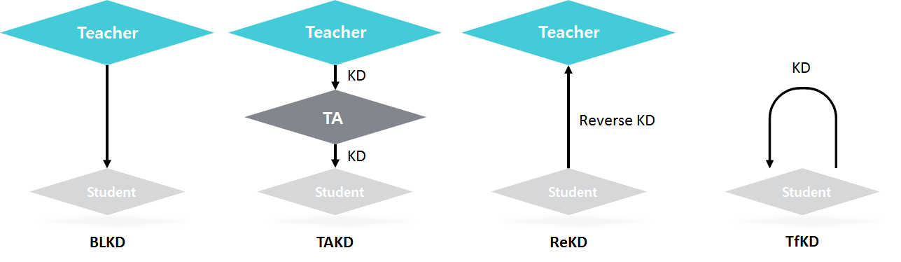
Various KD methods

Slide 5
Model : GSKD (Growing Student KD)
Teacher
KD
New Teacher
KD
Student 3
Reverse KD
KD
KD
Reverse KD
Student 2
Student 1
Reverse KD
Infancy / Childhood / Adolescence / Adult
Transfer extracted feature in previous step
Notes:
Not necessary to be 4 steps
TA와 달리 아래에서 위로 접근
마지막 New Teacher는 기존의 Reversed KD와 비교할 수 있을 듯(일종의 partitioned Reverse KD이니까)

Slide 6
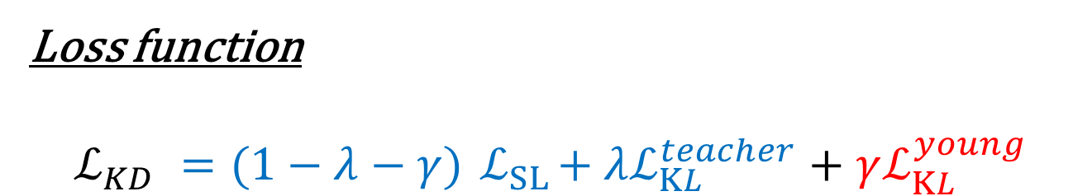
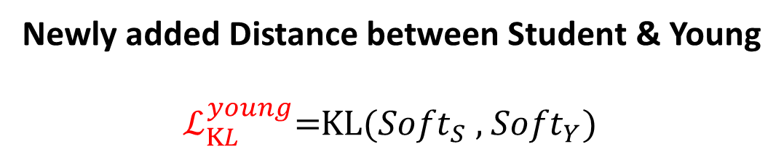
Model : GSKD (Growing Student KD)
Loss function
$$ℒ_{KD} =(1−λ−γ){ ℒ}_{SL}+λℒ_{KL}^{teacher}+γℒ_{KL}^{young}$$
Newly added Distance between Student & Young
${ ℒ}_{KL}^{young}=$KL(${Soft}_{S}$ , ${Soft}_{Y}$)
Notes:
Not necessary to be 4 steps
TA와 달리 아래에서 위로 접근
마지막 New Teacher는 기존의 Reversed KD와 비교할 수 있을 듯(일종의 partitioned Reverse KD이니까)

Slide 7
Experimental Setup
Dataset
CIFAR-10
Implementation Details
Batch size : 128
Epochs : 80
Momentum : 0.9
Learning rate : 0.1 to 0.001
Weight decay : 0.0001
Network Architectures
ResNet26 (89.71%) : teacher
ResNet8, 14, 20, 26: student
Training Methods
NOKD (No KD) : standard training
BLKD (Baseline KD) : normal KD
GSKD (Growing Student KD) : proposed
ResNet26
KD
ResNet26
KD
ResNet20
Reverse KD
KD
KD
ResNet14
Reverse KD
ResNet8
Reverse KD
Notes:
Not necessary to be 4 steps
TA와 달리 아래에서 위로 접근
마지막 New Teacher는 기존의 Reversed KD와 비교할 수 있을 듯(일종의 partitioned Reverse KD이니까)

Slide 8
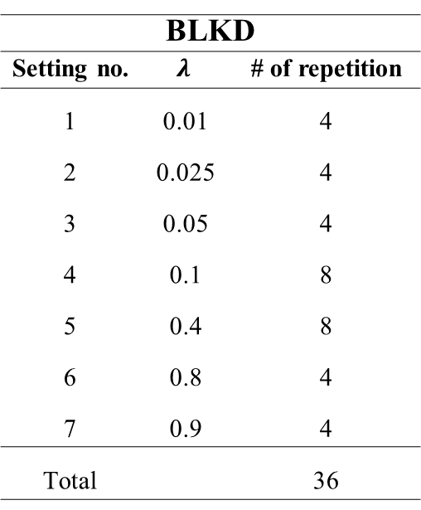
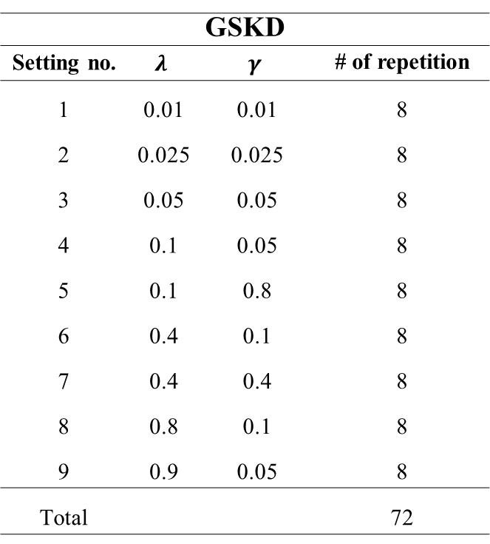
Experimental Setup
Hyperparameter settings
BLKD
Setting no. | $$λ$$ | # of repetition
1 | 0.01 | 4
2 | 0.025 | 4
3 | 0.05 | 4
4 | 0.1 | 8
5 | 0.4 | 8
6 | 0.8 | 4
7 | 0.9 | 4
Total |  | 36
GSKD
Setting no. | $$λ$$ | $$γ$$ | # of repetition
1 | 0.01 | 0.01 | 8
2 | 0.025 | 0.025 | 8
3 | 0.05 | 0.05 | 8
4 | 0.1 | 0.05 | 8
5 | 0.1 | 0.8 | 8
6 | 0.4 | 0.1 | 8
7 | 0.4 | 0.4 | 8
8 | 0.8 | 0.1 | 8
9 | 0.9 | 0.05 | 8
Total |  |  | 72
Notes:
Not necessary to be 4 steps
TA와 달리 아래에서 위로 접근
마지막 New Teacher는 기존의 Reversed KD와 비교할 수 있을 듯(일종의 partitioned Reverse KD이니까)

Slide 9
Result
Justification of young network in GSKD
Underperforming λ (0.8, 0.9) : BLKD has lower acc. than NOKD
ANOVA : check difference in acc. among hyperparameter settings
H₀ : setting (treatment) effects are equal vs. H₁ : not H₀
p-value of ANOVA
 | ResNet14 | ResNet20 | ResNet26
BLKD | 0.492 | 0.479 | 0.304
GSKD | < 0.001 | < 0.001 | < 0.001
Notes:
Not necessary to be 4 steps
TA와 달리 아래에서 위로 접근
마지막 New Teacher는 기존의 Reversed KD와 비교할 수 있을 듯(일종의 partitioned Reverse KD이니까)

Slide 10
Result
Accuracy improvement via GSKD
Maximal accuracy of trained student networks
 | ResNet8 | ResNet14 | ResNet20 | ResNet26
NOKD | 85.21 | 88.56 | 89.2 | 89.71
BLKD | 84.89 | 88.73 | 89.49 | 89.85
GSKD | 84.89 | 88.74 | 89.76 | 89.85
The size gap issue between Teacher and Student has been reported in [3]
GSKD consistently showed the highest accuracy
Notes:
Not necessary to be 4 steps
TA와 달리 아래에서 위로 접근
마지막 New Teacher는 기존의 Reversed KD와 비교할 수 있을 듯(일종의 partitioned Reverse KD이니까)

Slide 11
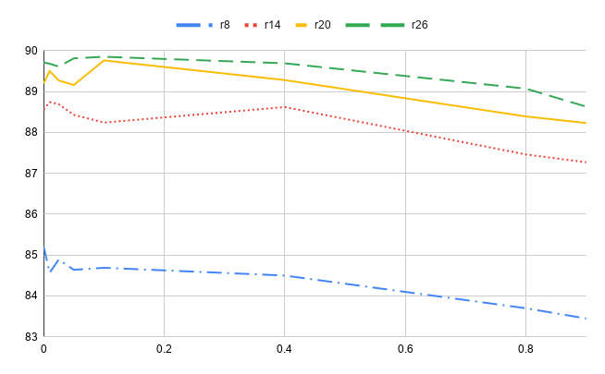
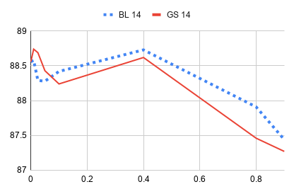
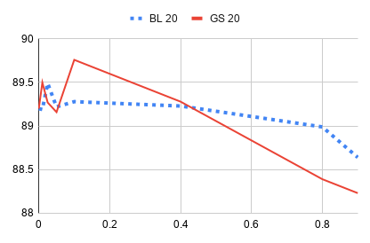
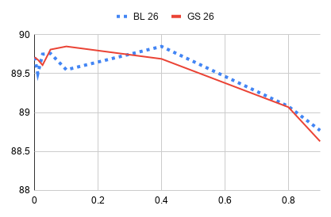
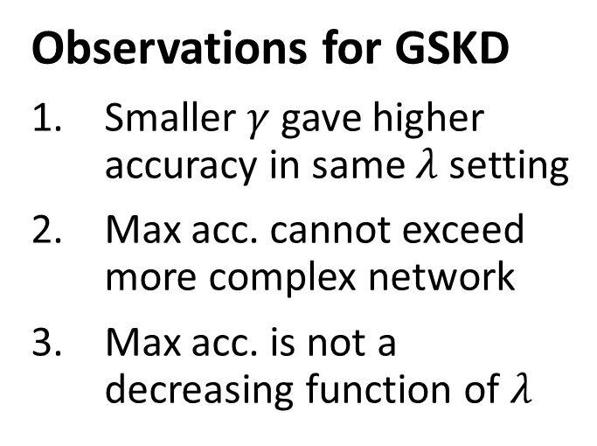
Result
Observations for GSKD
Smaller $γ$ gave higher accuracy in same $λ$ setting
Max acc. cannot exceed more complex network
Max acc. is not a decreasing function of $λ$
Notes:
Not necessary to be 4 steps
TA와 달리 아래에서 위로 접근
마지막 New Teacher는 기존의 Reversed KD와 비교할 수 있을 듯(일종의 partitioned Reverse KD이니까)

Slide 12
Conclusion
New improved KD model : GSKD
Using ANOVA, check the effect of young network
Show the superiority of GSKD with experiments
Future Work
Lack of time and computational resources
Hyperparameter tuning : Microsoft NNI
Application to other datasets : CIFAR-100 etc.
Notes:
Not necessary to be 4 steps
TA와 달리 아래에서 위로 접근
마지막 New Teacher는 기존의 Reversed KD와 비교할 수 있을 듯(일종의 partitioned Reverse KD이니까)

Slide 13
References
[1] Buciluǎ, Cristian, Rich Caruana, and Alexandru Niculescu-Mizil. "Model compression." Proceedings of the 12th ACM SIGKDD international conference on Knowledge discovery and data mining. ACM, 2006.
[2] Hinton, Geoffrey, Oriol Vinyals, and Jeff Dean. "Distilling the knowledge in a neural network." arXiv preprint arXiv:1503.02531 (2015).
[3] Mirzadeh, Seyed-Iman, et al. "Improved knowledge distillation via teacher assistant: Bridging the gap between student and teacher." arXiv preprint arXiv:1902.03393 (2019).
[4] Yuan, Li, et al. "Revisit Knowledge Distillation: a Teacher-free Framework." arXiv preprint arXiv:1909.11723 (2019).
[5] Szegedy, Christian, et al. "Rethinking the inception architecture for computer vision." Proceedings of the IEEE conference on computer vision and pattern recognition. 2016.
[6] He, Kaiming, et al. "Deep residual learning for image recognition." Proceedings of the IEEE conference on computer vision and pattern recognition. 2016.
[7] Heo, B., et al. "Improving knowledge distillation with supporting adversarial samples." arXiv preprint arXiv:1805.05532 3 (2018).

